Slide 1


ZOMATO SALES ANALASIS
MR. GURRAM SANTOSH KUMAR
DATE: 28/06/2024

Slide 2
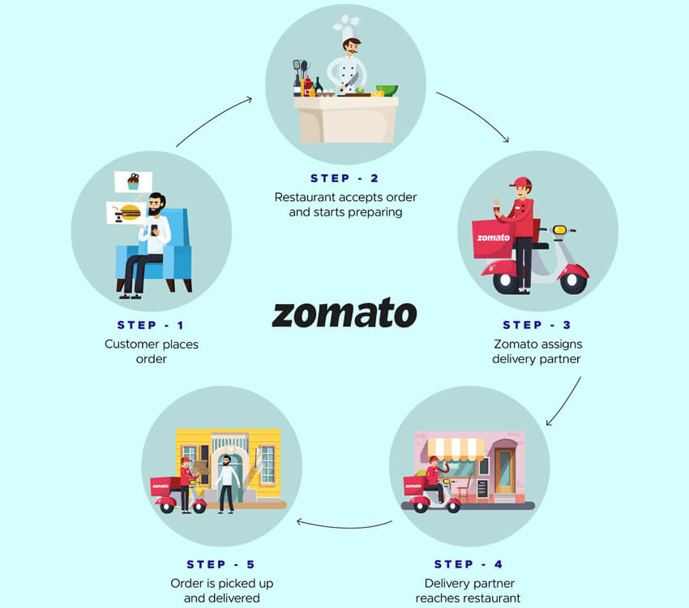
ABOUT ZOMATO
HOW ZOMATO WORKS
Launched in 2010, Our technology platform connects customers, restaurant partners and delivery partners, serving their multiple needs.
Customers use our platform to search and discover restaurants, read and write customer generated reviews and view and upload photos, order food delivery, book a table and make payments while dining-out at restaurants.
On the other hand, we provide restaurant partners with industry-specific marketing tools which enable them to engage and acquire customers to grow their business while also providing a reliable and efficient last mile delivery service.
We also operate a one-stop procurement solution, Hyper pure, which supplies high quality ingredients and kitchen products to restaurant partners.
We also provide our delivery partners with transparent and flexible earning opportunities.

Slide 3


Problem Statement
You are hired as a consultant data analyst by Zomato where the team is looking for expansion and opening restaurants. Your task is to come up with strategies/suggestions about opening newer restaurants.
In Further slide we will be analysing and suggesting location for opening new branches

Slide 4


Data Overview
In the dataset, we have information about various restaurants, including their addresses, cuisines served, accepted currencies, availability of online delivery services, whether table booking options are offered, and the average price for a couple dining at each establishment.
This data helps us understand where the restaurants are located, what types of food they offer, how they handle transactions, whether they provide delivery services, if reservations can be made in advance, and how much a typical meal for two might cost.
Total Number of Restaurant is 9542 including all the Countries Data.
Total Voters in all Countries is 1495919.
Total Average Rating of all countries data is 3.27381151
Total Sum of Average cost for two is 11453512.

Slide 5

Data cleaning : Deleted missing values data rows as it was less than 5% of the data and removed duplicates to ensure data accuracy
Data enrichment : Data was enhanced by using VLOOKUP function for country name and customized price column for cross references with the external data sources.
Descriptive analysis: Pivot on-going were used to summarize the data for understanding the cuisine and year trend in the on-going market of regions of different countries , along with big cuisine-based data of specific regions of different countries.
Customer preference analysis: Conducted cuisine-based customer analysis in different regions of different countries using avg-Rating
Restaurant performance analysis: Used rating and average cost to make an overview of performance for restaurants of different regions o different countries.
Visualization: Dynamic charts and dashboard are created for user interaction with data exploration .

Slide 6
Data Cleaning and pre-processing Output
The data was cleaned with missing values and replaced date column sign ‘_’ with ‘-’For getting year
Unified the price with currency abbreviation/symbol into customized column.
The name of country was introduced to country for better cross-references

Slide 7
Global Restaurant Count: Exploring the World's Dining Landscape
Insights:
In the global restaurant arena, India boasts the highest number of restaurants, while the USA closely follows in second place.
With such a vast presence, competition for opening new restaurants is notably heightened.
Recommendations: These should give a well-rounded view of Zomato’s restaurant presence globally and highlight areas for potential market development.

Slide 8
Global Average Votes: Evaluating Consensus Across Borders
Insights:
In a global survey, Indonesia, the United Arab Emirates, the United States of America, and Turkey emerged as the countries with the highest average number of votes across the world.
Surprisingly, despite its large number of restaurants, India does not top the list in terms of average votes.
This indicates that while India may have numerous restaurants, the level of voter engagement is lower compared to Indonesia, the UAE, USA, and Turkey.
Understanding this distinction is crucial for assessing the dynamics of the restaurant industry in different regions

Slide 9
Restaurant Openings Over Time: Tracking Growth by Year
Insights:
From 2010 to 2018, a steady stream of new restaurants emerged onto the global scene.
However, it's noteworthy that the years 2011, 2017, and 2018 stand out as the periods when the highest number of restaurants were opened worldwide.
Conversely, in 2012, 2015, and 2016, although significant numbers of restaurants were established, they appeared relatively lower compared to the peak years of restaurant openings.
Understanding these trends provides valuable insights into the evolving landscape of the restaurant industry over the past decade.

Slide 10
Average Ratings Across Countries: Exploring Culinary Consensus Globally
Insights:
In terms of average ratings, the Philippines, Indonesia, New Zealand and Turkey stand out as the top four countries, boasting the highest average ratings for restaurants.
However, India's average rating falls behind, ranking as the lowest among the compared countries.
This highlights significant variations in the quality perception of restaurants across different nations, with the Philippines, Indonesia, New Zealand and Turkey leading the pack in customer satisfaction.

Slide 11
Average Expenditure by Country: Assessing Dining Habits Worldwide
Insights:
When analyzing the average cost for two per meal by country, a clear contrast emerges.
The Philippines and Singapore top the charts with the highest average expenditure, indicating relatively higher food costs compared to other nations.
Conversely, India and Turkey register lower averages, suggesting more affordable dining options in these countries.
This disparity underscores the diverse economic landscapes and consumer spending habits across different regions.

Slide 12
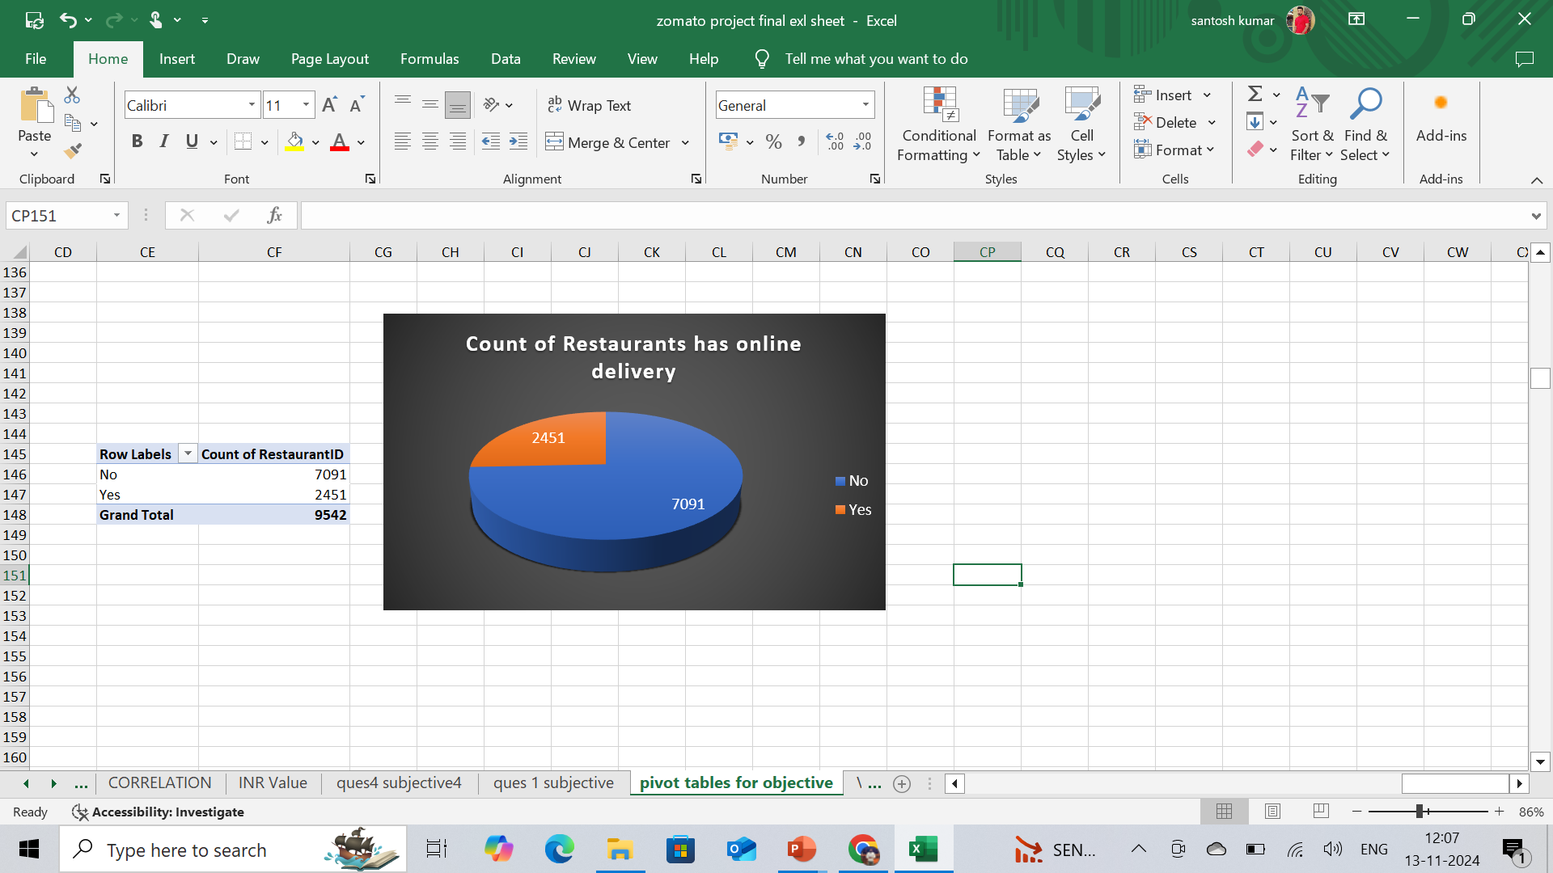


Restaurant Distribution by having online delivery :
Insights:
Out of the 9542 restaurants in our dataset, only 2451 offer online delivery services.
This means that a significant majority of 7091 restaurants, comprising the majority, do not provide online delivery options.
This highlights the prevailing trend where the majority of restaurants are not actively participating in online delivery services.

Slide 13
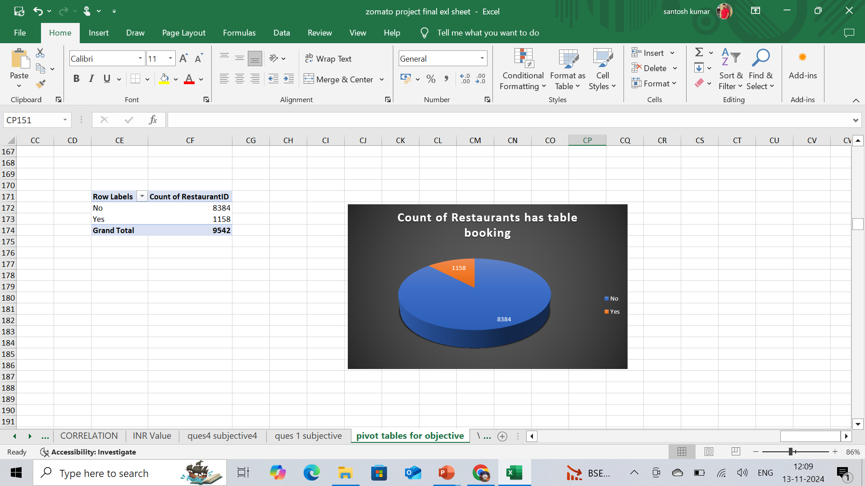

Restaurant Distribution by having table booking :
Insights:
Out of the 9542 restaurants in our dataset, only 1158 offer has table booking services.
This means that a significant majority of 8384 restaurants, comprising the majority, do not provide table booking options.
This highlights the prevailing trend where the majority of restaurants are not actively participating in table booking.

Slide 14
Suggested countries for Expansion: For New Restaurant opening
Australia
Canada
New Zealand
Qatar
Singapore
Turkey
United Arab Emirates
United Kingdom
Insights:
To capitalize on higher competition markets, we're focusing on Australia, Canada, New Zealand, Qatar, Singapore, United Arab Emirates, and United Kingdom, excluding USA and India.
As per our data we can expect to have a higher chance of success in these countries as they satisfy the price range and also has a low competitor market
Therefore, we see an opportunity to establish new restaurants in these markets.
Online delivery can bring a greater impact to these countries as they do not have any online food delivery services

Slide 15
Recommended countries for Expansion
Selection Criteria
Australia
Canada
New Zealand
Qatar
Singapore
Turkey
United Arab Emirates
United kingdom
Sum of Average cost for two “<=5000”.
Countries :
Average rating “>=3.5”.
Count of restaurant in between 20 to 80
As per our data we can expect to have a higher chance of success in these countries as they satisfy the price range and also has a low competitor market
Online delivery can bring a greater impact to these countries as they do not have any online food delivery services

Slide 16
STATES DATA SUITABLE FOR EXPANSION:
Abu Dubai
East Ballina
Macedon
Sharjah
Ankara
Edinburgh
Manchester
Singapore
Armidale
Flaxton
Mayfield
Tanunda
Auckland
Forrest
Middleton Beach
Trentham East
Balingup
Hepburn springs
Montville
Istanbul
Beechworth
Huskisson
Palm cove
Victor Harbor
Birmingham
Inverloch
Paynesville
Vineland station
Chartham-Kent
Lakes Entrance
Pinola
Wellington City
Consort
London
Phillip Island
Yorkton
Dicky beach
Lorna
Dubai
Doha
Insights:
These locations has rating above 3.5 also satisfy the price range of 1-3.
The higher rating Indicates a good market of consumers availability and also has cost efficiency.
These selections are based on areas where the average restaurant rating exceeds 4, indicating a thriving dining scene and high levels of customer satisfaction.

Slide 17

RECOMMENDED CUISINES
American Asian, Burger
Burger,Sandwich,Steak
American, BBQ Sandwich
Cajun
American Desserts
Desserts, Bar Food
American,Desserts,Steak
Hawaiian
Average rating ‘>4.3’
American, sandwich, salad
Hawaiian, Sea Food
Sum of voters‘>’1000’
American ,Sandwich, Tea
Indian, Continental
American Seafood Sushi
Indian, Rajasthan's
Insights:
Expected to have a positive impact on the consumers as those are in the brackets of Highest Restaurant Rating.
Based on the country and cities , the cuisines may differ from various locations
From my suggested Country and cities , picked the famous cuisines based on location , so that we can satisfy the customer and can get good feedback and rating as well
American,Southern,SouthWestern
Italian Deli
BBQ,Burger,Desserts
Latin American, Mexican, Southern
BBQ,Caribbean,Seafood
New American, Tapes
Brazilian, Steak
Pub food
Breakfast, Mexican
World Cuisine, Patisserie Cafe
British,BarFood,Steak
Cuban, Spanish

Slide 18
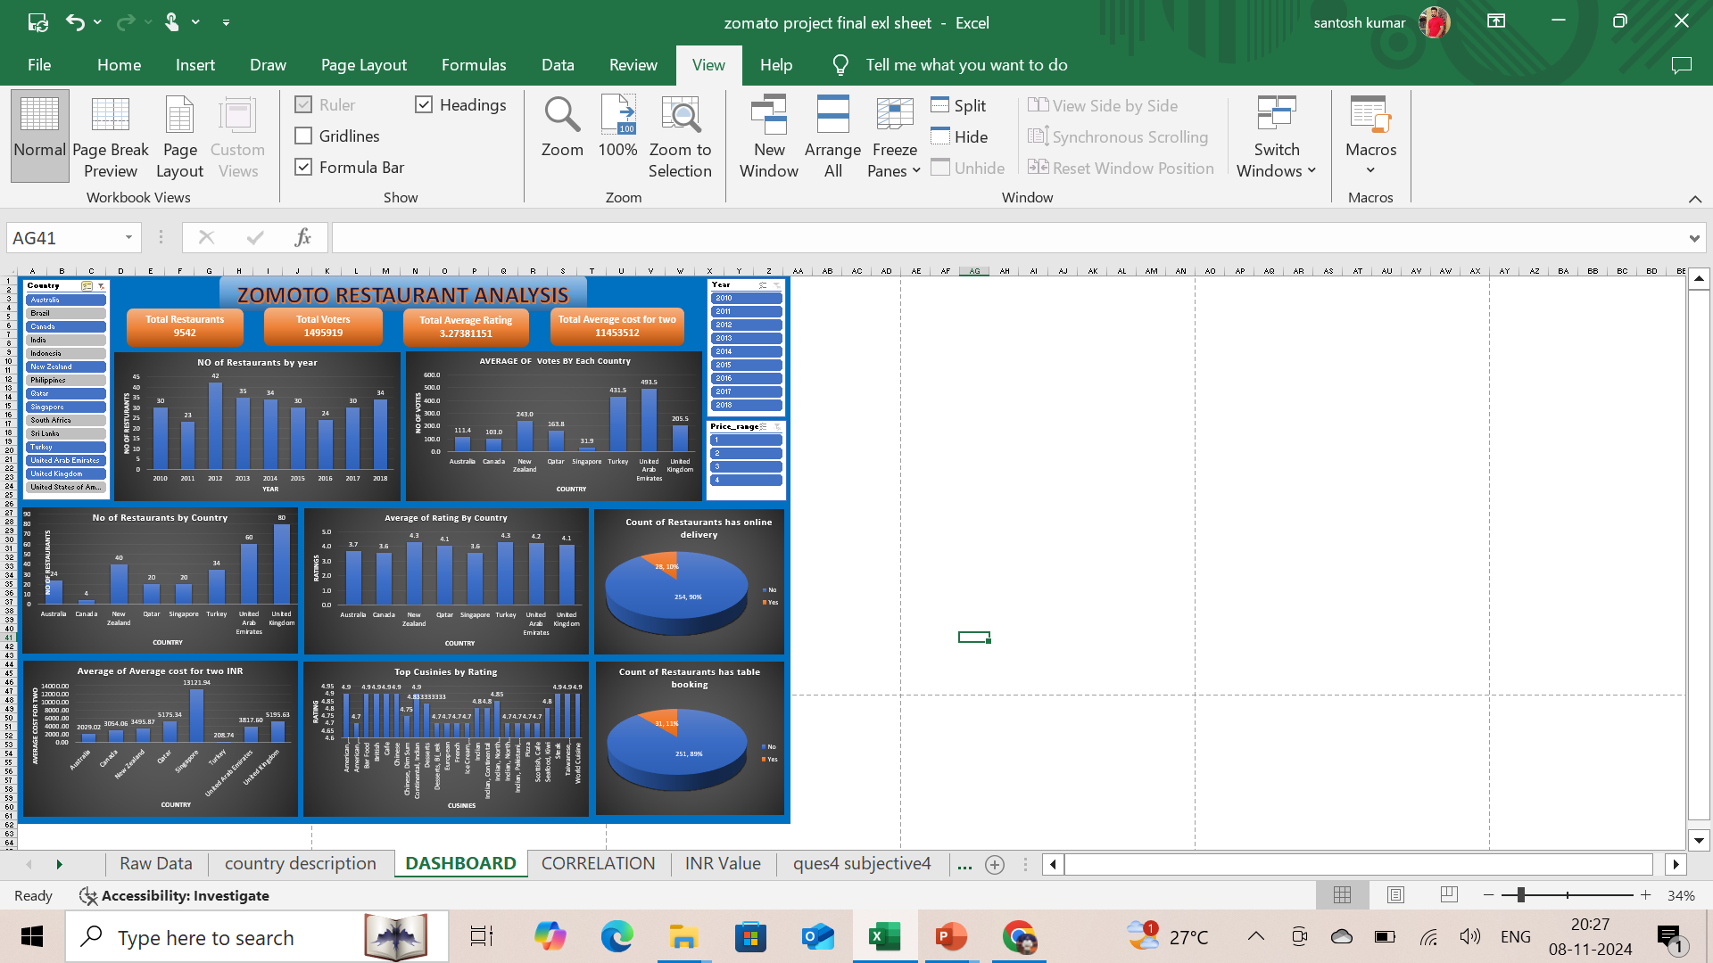
DASHBOARD

Slide 19
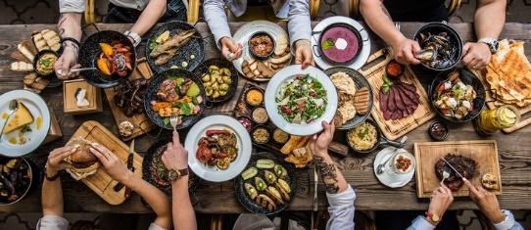
Conclusion
After thorough analysis of the problem statement and considering our objective of expansion and opening new restaurants, we recommend the following countries are suitable locations for launching new branches.
Countries : Australia, Canada, New Zealand, Qatar, Singapore, United Arab Emirates, and United Kingdom
These selections have been made based on factors such as market potential, customer demand, and favorable business environments, ensuring optimal opportunities for successful expansion and growth.

Slide 20
REFERENCES :
Mentor sessions by PRINCE POONIA and Kritika Agarwal
Sample project by newton school.
Taking some input and knowledge search from online web-sites YouTube, Google, Zomato website
Thank you…..

